Slide 1

Exception
Week 6

Slide 2
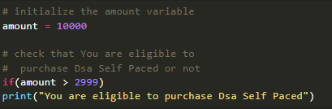
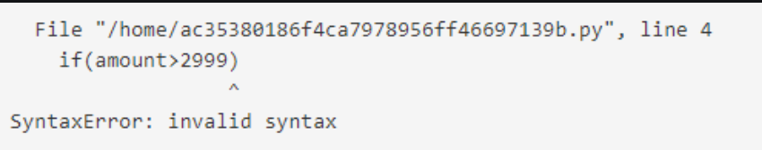
Difference between Syntax error and Exception
Syntax Error: As the name suggests this error is caused by the wrong syntax in the code. It leads to the termination of the program.

Slide 3
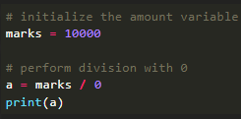
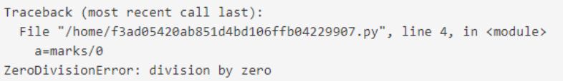
Exception
Exceptions are raised when the program is syntactically correct, but the code resulted in an error.
This error does not stop the execution of the program, however, it changes the normal flow of the program.
In the above example raised the ZeroDivisionError as we are trying to divide a number by 0.

Slide 4
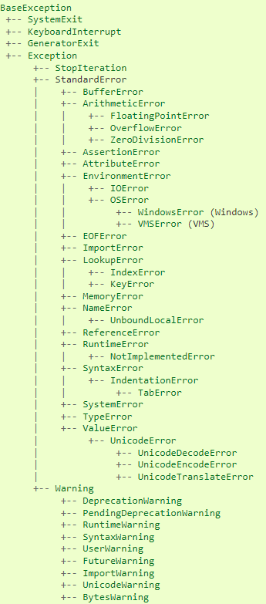
Exception Hierarchy

Slide 5

Try and Except Statement – Catching Exceptions
Try and except statements are used to catch and handle exceptions in Python.
Statements that can raise exceptions are kept inside the try clause and the statements that handle the exception are written inside except clause.

Slide 6
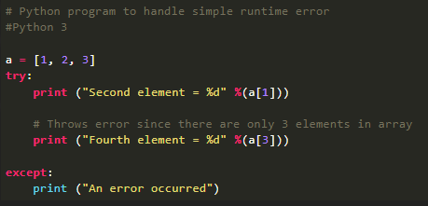

Example
Let us try to access the array element whose index is out of bound and handle the corresponding exception.
In the example, the statements that can cause the error are placed inside the try statement (second print statement in our case). The second print statement tries to access the fourth element of the list which is not there and this throws an exception. This exception is then caught by the except statement.
In the above example, the statements that can cause the error are placed inside the try statement (second print statement in our case). The second print statement tries to access the fourth element of the list which is not there and this throws an exception. This exception is then caught by the except statement.

Slide 7
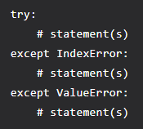
Catching Specific Exception
A try statement can have more than one except clause, to specify handlers for different exceptions.
Note that at most one handler will be executed. For example, we can add IndexError in the code. The general syntax for adding specific exceptions are –

Slide 8
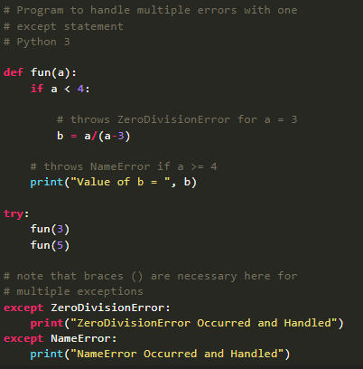

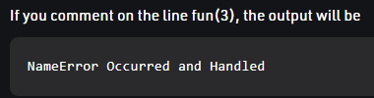
Example

Slide 9
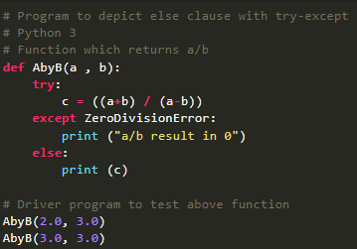

Try with Else Clause
In python, you can also use the else clause on the try-except block which must be present after all the except clauses.
The code enters the else block only if the try clause does not raise an exception.

Slide 10
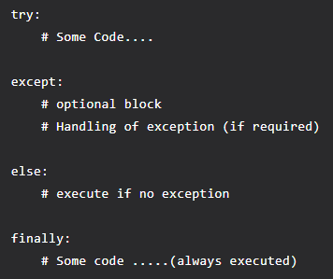
The “Finally”, Keyword in Python
Python provides a keyword finally, which is always executed after the try and except blocks.
The final block always executes after normal termination of try block or after try block terminates due to some exception.

Slide 11
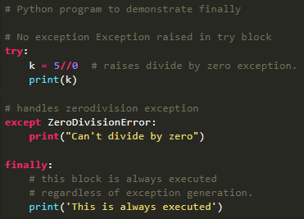

Example

Slide 12
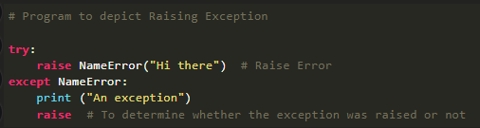
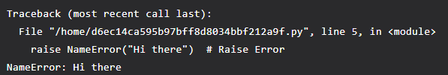
Raising Exception
The raise statement allows the programmer to force a specific exception to occur.
The sole argument in raise indicates the exception to be raised. This must be either an exception instance or an exception class (a class that derives from Exception).
The output of the above code will simply line printed as “An exception” but a Runtime error will also occur in the last due to the raise statement in the last line. So, the output on your command line will look like

Slide 13
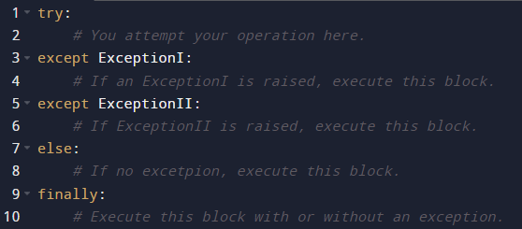
Summary

